Slide 1
Time Series Fundamentals

Slide 2
The Logic of Time Series Analysis

Slide 3
Step 1: Nature of Time Series
We’ve been working with cross-sectional data – that is data that has been collected all at the same time
This data is collected at one point in time and oftentimes comes from a survey and looks at a relationship between variable A and variable B frozen at one period in time…
But in the “real world” things are changing with time
Some things are one time “shock” things that have effects – this is where we are going to start…
Even that happy relationship between variable A and variable B may change over time – rhut rho…

Slide 4
Step 1: Nature of Time Series
But there is a whole world of business data out there that changes in relationship to time
Monthly sales data
Daily stock prices
Exchange rates
Price of commodities, goods and services
Any sort of data that is collected over time and has some sort of time-related

Slide 5
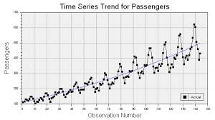
Step 1: Nature of Time Series
Why chase time series? Let’s see why it might be a good idea…
Here is some time series data – we can capture the linear trend component with a regression model

Slide 6
Step 1: Nature of Time Series
You can also see seasonality in this data as the data goes up and then down and then up again, then down again, etc.
Although we haven’t covered it, there are ways to model that seasonality trend as well..

Slide 7
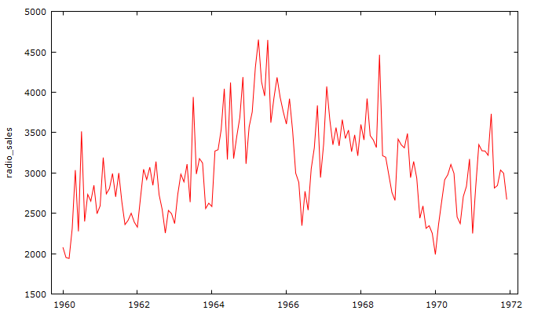
Step 1: Nature of Time Series
Look at how the data whipsaws around here – would we want to try to model that? Well, it certainly affects radio sales so we should be interested in trying to model it…but it seems hopeless…

Slide 8
Step 1: Nature of Time Series
Maybe not hopeless – if it were truly random we probably would see it bounce up and down randomly

Slide 9
Step 1: Nature of Time Series
So there is some pattern to this, but we don’t seem to have any independent variables to model it with – we are toast, right?

Slide 10
Step 1: Nature of Time Series
Maybe not toast comrade! There are likely a number of variables influencing radio sales and they probably move in correlation to time. So maybe we can us time to help use predict this mess!

Slide 11
Analytical Tools

Slide 12

Step 1: Time Series Brought to You By…
Some of the time series analytics in this lecture deck provided by GRETL – a free time series software package for windows and mac OSX
http://gretl.sourceforge.net/
(and yes…the scripting language for GRETL is called HANSL)

Slide 13



Step 1: Time Series Brought to You By…
Other time series analytics brought to you by SPSS and SAS

Slide 14
Typical Use, Data Sniff and IDRE

Slide 15
Step 1: Typical Use of the Technique
As the head of strategic analytics you have been asked to predict the sales of McFly hoverboards. You have the monthly sales figures for the last 5 years.

Slide 16
Step 1: Typical Use of the Technique
Our example: As head of sales for Lenex , want to analyze monthly sales for the last 12 years. So you have 12x12 or 144 months of sales data.

Slide 17
Step 2: Inspect the Data
Our example: As head of Lenex radio sales, here are the last 12 years sales by month (144 observations)
sales
3083
3149
3218
3239
3295
3374
3475
3569
3597
3725
3744
3822
3888
4102
4101
Notes:
If students will be required to write a research proposal or conduct a study as a course project, or if students have ongoing research projects such as theses or dissertations, and if the class is reasonably small, it may be useful to elicit descriptions of their research interests early in the course and use these research questions as a focus for discussion. If the class is large or students do not have well defined research interests, you may want to focus discussion on the empirical examples presented in the chapter.

Slide 18
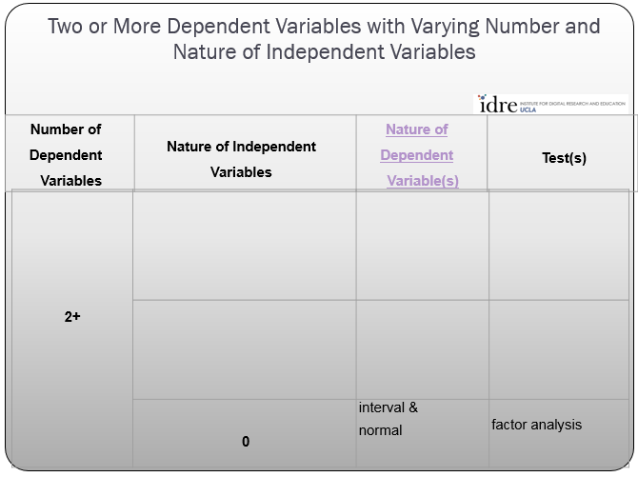
Step 3: Analysis Run
a. Determine the technique to use from idre chart
Sadly, the IDRE chart fails us here. They don’t list cluster analysis in the chart. But we can do it here ourselves.
1
Typically Interval
Various Time Series Models
0 or more

Slide 19
Time Series Process and Some Terms

Slide 20
Step 3: Analysis Run
First let’s learn about the forecasting process
Problem definition
Data collection
Data analysis
Model selection and fitting
Model validation
Forecasting model deployment
Monitoring forecasting model performance

Slide 21
Step 3: Analysis Run
Now some time series terms
sales | modeled sales
3083 | 2910
3149 | 3230
3218 | 3149
3239 | 3260
3295 | 3321
3374 | 3420
3475 | 3390
3569 | 3578
3597 | 3622
3725 | 3705
 | 3777
 | 3858
 | 3913
 | 4027
 | 4111
Actual data
Fitted values
Forecast data

Slide 22
Step 3: Analysis Run
Now some time series terms
sales | modeled sales | error
3083 | 2910 | -173
3149 | 3230 | 81
3218 | 3149 | -69
3239 | 3260 | 21
3295 | 3321 | 26
3374 | 3420 | 46
3475 | 3390 | -85
3569 | 3578 | 9
3597 | 3622 | 25
3725 | 3705 | -20
3744 | 3777 | 33
3822 | 3858 | 36
3888 | 3913 | 25
4102 | 4027 | -75
4101 | 4111 | 10
Actual data
residuals
Future data arrives
Forecast errors

Slide 23
Moving Averages
Theoretical Stuff

Slide 24
Step 3: Analysis Run
Theoretical Perspective on Moving Averages
Let’s look first at the theoretical idea of a moving average
Let’s imagine that we are looking at the change in oil prices over time, we will call that change X_{t} that might come from a specific type of shock or event
So let’s imagine that our moving average change in oil price X_{t} can be described by the equation
X_{t} = E_{t} + Θ E_{t-1}

Slide 25
Step 3: Analysis Run
Theoretical Perspective on Moving Averages
X_{t} = E_{t} + Θ E_{t-1}
Change in oil price
Some error (shock) or disturbance term
Some constant theta times the error term from time t-1
This is a first order moving average process – it depends upon the value of the previous term

Slide 26
Step 3: Analysis Run
Theoretical Perspective on Moving Averages
X_{t} = E_{t} + .5 E_{t-1}
Change in oil price
Some error or disturbance term
Some estimate theta times the error term from time t-1
Let’s assume that our theta has the value of .5

Slide 27
Step 3: Analysis Run
Theoretical Perspective on Moving Averages
So let’s see how this works out across time…
Time
Oil price | 30 | 30 | 50 | 60 | 60 | 60
X_{t} change in oil price | 0 | 0 | 20 | 10 | 0 | 0
Tanker sinks | 0 | 0 | 1 | 0 | 0 | 0
E_{t} | 0 | 0 | 20 | 0 | 0 | 0
.5 E_{t-1} |  | 0 | 0 | 10 | 0 | 0
X_{t} = E_{t} + .5 E_{t-1}

Slide 28
Step 3: Analysis Run
Theoretical Perspective on Moving Averages
Note that a first ordering moving process has an effect on just two time periods then disappears…
Time
Oil price | 30 | 30 | 50 | 60 | 60 | 60
X_{t} change in oil price | 0 | 0 | 20 | 10 | 0 | 0
Tanker sinks | 0 | 0 | 1 | 0 | 0 | 0
E_{t} | 0 | 0 | 20 | 0 | 0 | 0
.5 E_{t-1} |  | 0 | 0 | 10 | 0 | 0
X_{t} = E_{t} + .5 E_{t-1}

Slide 29
Moving Averages
Actual Effects of Moving Averages

Slide 30
H
Step 3: Analysis Run
Typical Time Series Data Set
Lenex Radio Sales (in units sold)

Slide 31
Step 3: Analysis Run
Typical Time Series Data Set
Notice how “jaggy” the sales line is. It’s a bit hard to interpret, especially if someone asks you how sales trends are going. So in time series analyses there is a way to help smooth out the “jaggys” and it’s called a moving average.

Slide 32

Step 3: Analysis Run
Moving Averages
Here is the formula for a moving average. It works pretty much like you would think an average works…
Value for time period t
Number of time periods averaged

Slide 33
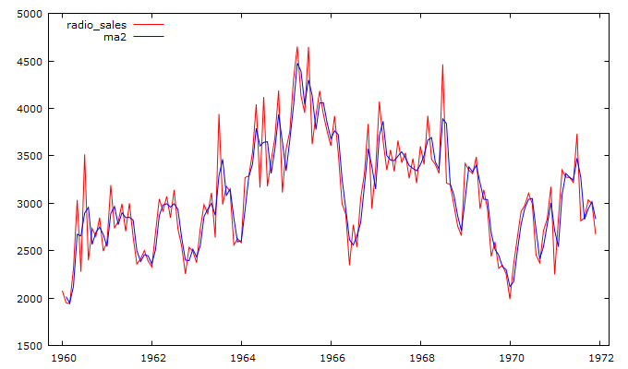
Step 3: Analysis Run
Moving Averages ma(1)
Let’s start with ma(1) - a moving average with two terms sales and sales(-1)

Slide 34
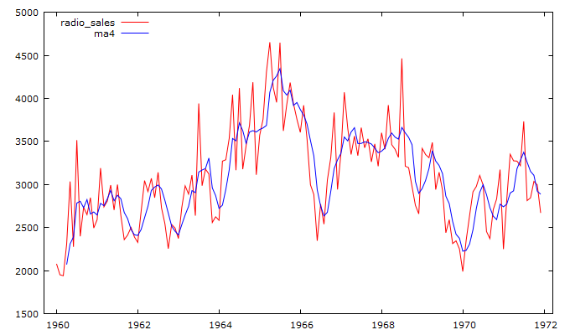
Step 3: Analysis Run
Moving Averages ma(3)
Try again with a larger window – ma(3), hmm a bit smoother…

Slide 35
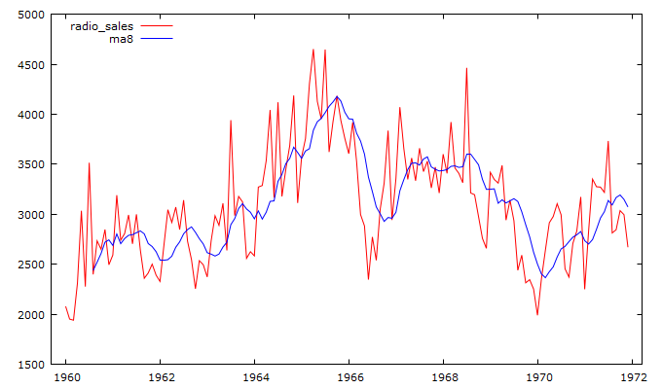
Step 3: Analysis Run
Moving Averages ma(7)
Let’s put our foot down – ma(7), hmm that looks better…

Slide 36
Step 3: Analysis Run
Hanning Filter
The previous moving averages were linear – all the points had equal weight. There are other possibilities – one of which is called the Hanning filter. A Hanning filter is a weighted, centered moving average. Let’s look at the formula for a three period Hanning filter:
M_{t}^{H} = 0.25 y_{t+1} + .5y_{t} + .25y_{t-1}
Value for time period t+1
Value for time period t
Value for time period t-1

Slide 37
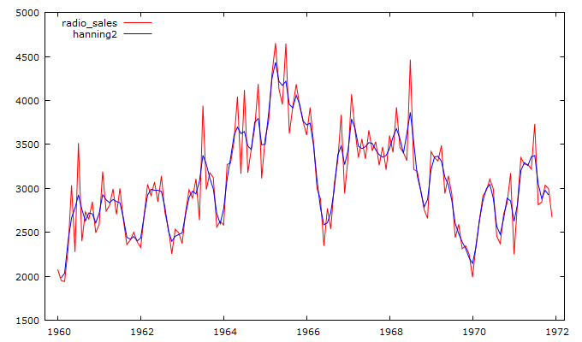
Step 3: Analysis Run
Hanning Filter
Let’s see what the centered Hanning filter in the last slide looks like…

Slide 38
Autoregressive Processes
Theoretical Stuff

Slide 39
Step 3: Analysis Run
Theoretical Perspective on Autoregressive Processes
Let’s look first at the theoretical idea of an autoregressive process
Let’s imagine that we are looking at the change in oil prices over time, we will call that change X_{t} that might come from a specific type of shock or event
So let’s imagine that our autoregressive change in oil price X_{t} can be described by the equation
X_{t} = ρX_{t-1} + E_{t}

Slide 40
Step 3: Analysis Run
Theoretical Perspective on Autoregressive Processes
X_{t} = ρX_{t-1} + E_{t}
Change in oil price
Some correlation times the term from time t-1
Error that represents some shock
This is a first order autoregressive process – it depends upon the value of the previous term

Slide 41
Step 3: Analysis Run
Theoretical Perspective on Autoregressive Processes
X_{t} = .4X_{t-1} + E_{t}
Change in oil price
Some correlation times the term from time t-1
Error that represents some shock
Let’s assume that our ρ has a value of .4

Slide 42
Step 3: Analysis Run
Theoretical Perspective on Autoregression
So let’s see how this works out across time…
Time
Oil price | 30 | 30 | 50 | 58 | 61.2 | 62.48
X_{t} change in oil price | 0 | 0 | 20 | 8 | 3.2 | 1.28
ME terror attack in oil field | 0 | 0 | 1 | 0 | 0 | 0
E_{t} | 0 | 0 | 20 | 0 | 0 | 0
.4 X_{t-1} |  | 0 | 0 | 8 | 3.2 | 1.28
X_{t} = .4X_{t-1} + E_{t}

Slide 43
Step 3: Analysis Run
Theoretical Perspective on Moving Averages
So let’s see how this works out across time…
Time
Oil price | 30 | 30 | 50 | 58 | 61.2 | 62.48
X_{t} change in oil price | 0 | 0 | 20 | 8 | 3.2 | 1.28
ME terror attack in oil field | 0 | 0 | 1 | 0 | 0 | 0
E_{t} | 0 | 0 | 20 | 0 | 0 | 0
.4 X_{t-1} |  | 0 | 0 | 8 | 3.2 | 1.28
Notice that unlike the ma(1) process, the ar(1) process keeps having an effect long beyond two time periods

Slide 44
“Hey Stand Still” – Being Stationary is Where Its At in Time Series…

Slide 45
Step 3: Analysis Run
The Important Idea of a Time Series Being Stationary
We need to crawl first before we can walk in times series. So we are going to start out dealing with time series that are stationary.
In non-technical terms, a stationary time series means that no matter part of the time series you examine, it is expected that the mean and the variance is constant over time. We know this because…
The entire joint distribution of two different series of points in time the mean and variance will be constant. That is, over the long run, the joint distribution of y_{t}, y_{t+1}, y_{t+2}, y_{t+3} will be the same as the joint probability distribution y_{t+k}, y_{t+k+1}, y_{t+k+2}, y_{t+k+3}
Also, the autocorrelation is also constant over time. Autocorrelation means the tendency for one data point at time t to be correlated with the data point at point time t-1. Autocorrelations are usually positive.

Slide 46
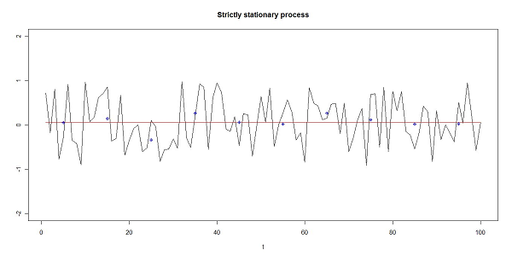
Step 3: Analysis Run
Stationary Time Series
Here is a strictly stationary time series. Note that the trend line through the points is flat or slope of zero, that is the mean does not change across time.

Slide 47
Step 3: Analysis Run
Stationary Time Series
Although a little harder to imagine, note that the variance across time appears to be pretty constant – there are no “squished” parts of the time series and no obvious sections of large outliers.

Slide 48
Step 3: Analysis Run
Stationary Time Series
Also note that across time, although hard to visualize,data points tend to seem to have very similar patterns of positive autocorrelation. If all three conditions are met, then the time series is strictly stationary. If the autocorrelation changed across time but the mean and variance stayed the same, then the time series is called “weak stationary”.

Slide 49
Step 3: Analysis Run
Stationary Time Series
We should note that in the real world strictly stationary time series are pretty rare. It’s really kind of an extreme scenario that turns out to be useful.
Why is a time series being stationary helpful? Because if you base your model off one part of the time series, then you know that the new time series points it forecasts will have to have the same mean, variance and autocorrelation. That makes for happier modeling!

Slide 50
Step 3: Analysis Run
Back to Autocorrelation
Let’s return to autocorrelation again for a moment.
You can examine the autocorrelation for any number of time lags between data points.
For example, you can look at the correlation between some data point y_{t} and y_{t-1}. That would be the autocorrelation for a lag of 1.
You can look at the correlation between some data point y_{t} and y_{t-2} which would be the autocorrelation for a lag of 2.
You can look at the correlation between some data point y_{t} and y_{t-3} which would be the autocorrelation for a lag of 3.

Slide 51
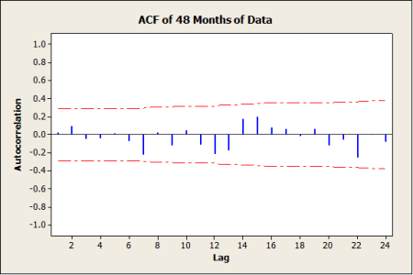
Step 3: Analysis Run
Back to Autocorrelation
We can plot out the autocorrelation for each of the lags on a plot, like the one below. This plot is a plot of the autocorrelation function or ACF.

Slide 52
Step 3: Analysis Run
Back to Autocorrelation
Notice that the pattern of autocorrelations varies – sometimes positive, sometimes negative. That is pretty typical of a stationary time series. Also note that none of the autocorrelations exceed the pvalue = .05 signified by the red dashed line. So the autocorrelations can assumed to be zero for all the lags and this confirms our hunch that the time series is stationary.

Slide 53
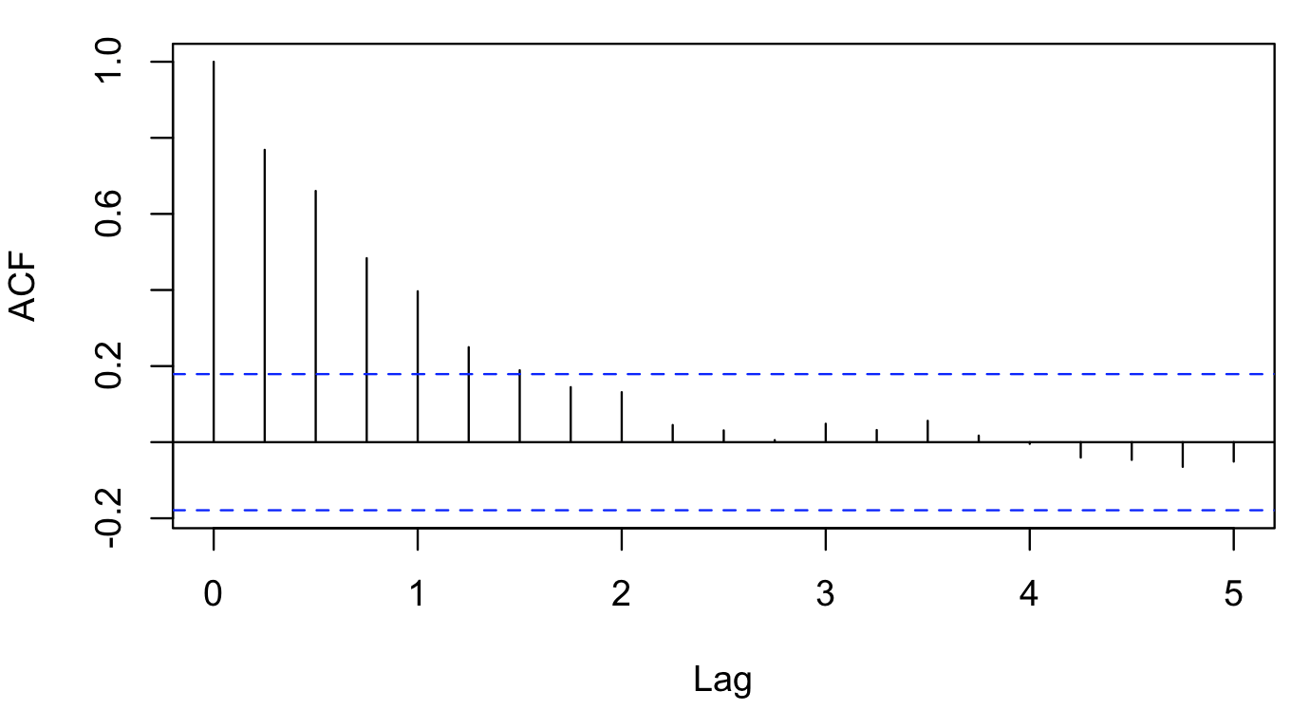
Step 3: Analysis Run
Back to Autocorrelation
Now what does the ACF look like for a non-stationary time series?
Notice that for the most part the autocorrelations are positive and don’t flip flop back and forth as much as the stationary example.
Importantly, note that the positive correlations reach beyond the blue dashed line of pvalue =.05, which means they are non-zero.

Slide 54
Step 3: Analysis Run
Back to Our Radio Sales Data
Now let’s look at our radio sales. Let’s see if it is stationary.
We can draw a trend line through it to see if there is no trend – that is, the mean is constant across all time points – that’s one of the criteria for a stationary time series. Does it look like there is NO trend?
.

Slide 55
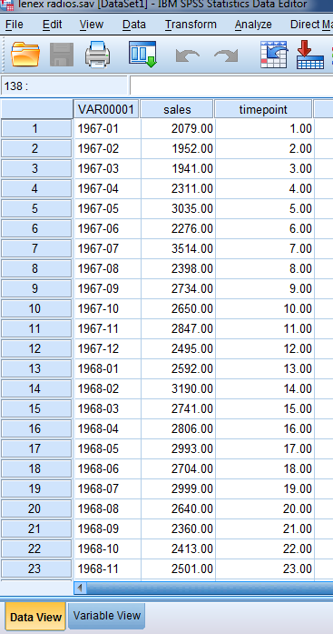
Step 3: Analysis Run
Is there just a single mean?
We can run a regression, regressing the each timepoint against sales.
If there is a trend, then we should see in the results of the multiple regression a significant overall regression model and a statistically significant pvalue for our timepoint variable.
Let’s see if that is the case!
.

Slide 56
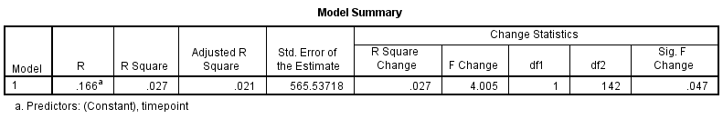
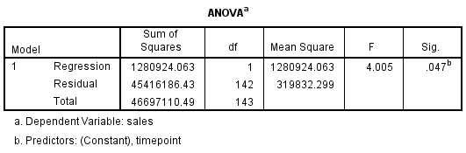
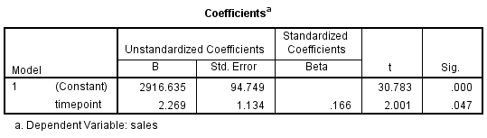
Step 3: Analysis Run
Is there just a single mean?
Here is the result of the regression. Does it look like the model is significant?
Does the regression coefficient for timepoint have a pvalue < .05?
Is this further evidence that the radio sales data is not stationary?
Warning: I am using this to illustrate a point – we will find out later that the autocorrelation in time series data artificially reduces the standard errors of the regression coefficients and so this test is technically not correct, but I want to use it here as a pedagogical crutch…
.

Slide 57

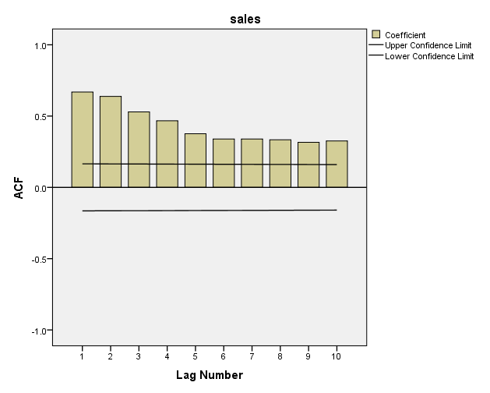
Step 3: Analysis Run
Back to Autocorrelation
Let’s try this now with our radio sales data set
Does our radio sales data ACF look similar to the non-stationary example we discussed earlier?
Our example non-stationary time series
Our radio sales time series

Slide 58
Step 3: Analysis Run
So no – our radio sales data is likely not stationary
Should we just pack up and head for Hills and Dales?
No, not yet! We can remove the trending component of our radio sales data and then it will be stationary!

Slide 59
Step 3: Analysis Run
Differencing
We can do something called differencing to get rid of the non-stationary component of the data (e.g. the trend).
We can do what’s called first differencing on our data. Here is the formula:
Xt = y_{t} - y_{t-1} = ∆y_{t}
Note: we could also try to do this by regressing the timepoint against sales and use the errors or residuals from that regression to remove the trend. But that assumes the trend is the same everywhere and it may not be. However, differencing is not affected by changes in trend and so it works regardless, so differencing is better for us.

Slide 60
Step 3: Analysis Run
Is there just a single mean?
There are two actual tests for single mean (e.g. no trend) available in SAS to help our stationarity tests
KPSS test
Phillips-Perron test
Each of these tests correctly tests for the single mean condition in the data

Slide 61
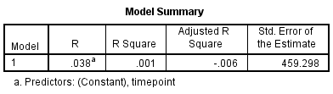
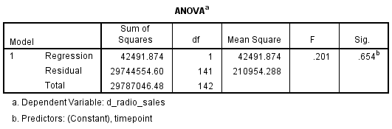
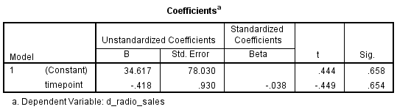
Step 3: Analysis Run
Back to Our Radio Sales Data after differencing
Now that I have differenced the radio sales data, does our regression look any better? Yes it does! The trend is gone!
.
Warning: I am using this to illustrate a point – we will find out later that the autocorrelation in time series data artificially reduces the standard errors of the regression coefficients and so this test is technically not correct, but I want to use it here as a pedagogical crutch…
.

Slide 62

Step 3: Analysis Run
Did differencing give us a single mean?
Here is the KPSS test for our differenced radio sales data – it should show a p > .05 value than before differencing
H₀: no evidence data has more than one mean (fits stationary criteria)
Halt: data has more than one mean (e.g. non-stationary)
Because p > .05, we cannot reject h₀ and so there is no evidence of more than one mean (fits criteria for stationary time series)

Slide 63

Step 3: Analysis Run
Did differencing give us a single mean?
Here is the Phillips-Perron test for our differenced radio sales data
H₀: no evidence data has single mean
Halt: data have single mean
Because p < .05 for single mean, we reject the null hypothesis and say there is evidence that there is only a single mean in the data (e.g. fits criteria for stationary time series)

Slide 64
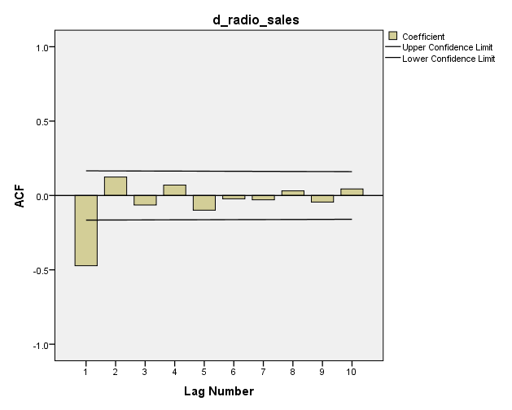
Step 3: Analysis Run
Back to Autocorrelation for a second
Does the differenced ACF look better?
Yes, see the flip flop pattern, so likely single mean – no trend

Slide 65
To every season, turn, turn, turn…

Slide 66
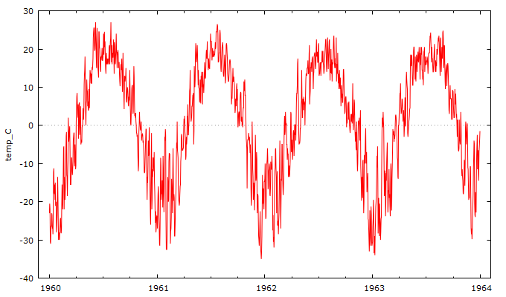
Step 3: Analysis Run
Seasonality
Remember we talked about seasonality? So here are the daily temperatures (in centigrade) for Dallas from 1960 to 1964. As you can clearly see, the seasons of the year play a big part in temperature.

Slide 67
Step 3: Analysis Run
Seasonality
Can we get rid of that seasonality? Then we could see what is left and decide if we can use time series models to model some more of it.

Slide 68
Step 3: Analysis Run
Seasonality
We can use differencing to get rid of seasonality as well.
We can do what’s called first differencing on our data. Here is the formula where d is the length of the season or period
∆_{d}y_{t} = y_{t} - y_{t-d}

Slide 69
Step 3: Analysis Run
Seasonality
So in this case since it’s daily temps, the period or seasonal d = 365 days
∆_{d}y_{t} = y_{t} - y_{t-365}

Slide 70
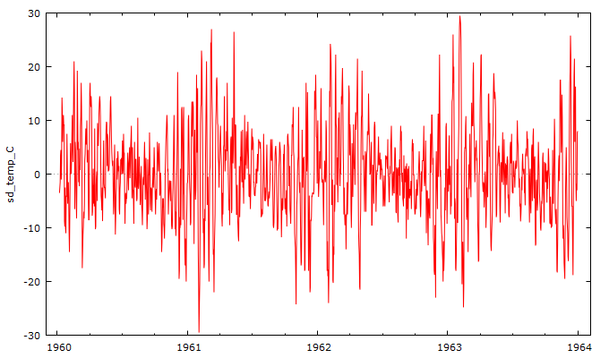
Step 3: Analysis Run
Seasonality
And here is the result…
∆_{d}y_{t} = y_{t} - y_{t-365}

Slide 71
Step 3: Analysis Run
Seasonality
Note you can also remove seasonality using regression models, but the models can be very, very ugly, so differencing is our best friend here…

Slide 72
So let’s see how this all fits together

Slide 73
Step 3: Analysis Run
So Let’s Restate the Time Series Process
Plot the time series and its basic features
Eliminate any trend or seasonal components
Develop a forecasting model for what’s left
Validate the model using a split sample technique
Examine the original data versus the fitted data
Examine the future arriving data versus the forecast data
Produce confidence intervals around the predictions
Monitor the forecasting model to ensure it doesn’t go in the ditch

